Slide 1
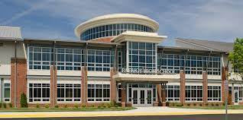
10504 Kettle Run Road Nokesville, Virginia
2022 - 2023
Patriot High School Gifted Education Program

Slide 2
1st Things 1st …
PLEASE…
Take one index card
Write your full name across the top of the card on the red line.
Under your name, please write the language in which your parents prefer written communication.
Write 3 interesting facts about you.
Write at least one thing you are looking forward to in High School.
Write some things you have some concerns about in High School
On the back of the card, list as many sports as you possibly can.
Seniors and Juniors outside of the East Wing of the National Gallery of Art in Washington, DC.
Look how thin that wall is!

Slide 3
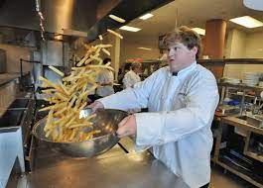
SCHEDULING
Students typically are scheduled for seven classes.
We alternate between an “Odd Day” (classes 1, 3, 5, 7)
and an “Even Day” (classes 2, flex/flex, 4, 6)
Each block is 90 minutes; Flex is a 45-minute enrichment
block that rotates through the classes grouped 1 & 2, 4 & 3,
5 & 6, 7 & Advisory.
“Advisory” allows for assemblies, collaboration, mentoring, and non-academic opportunities.
LUNCHES are 25 minutes during 4th and 5th blocks. There are four lunch shifts.
Lunch shifts are determined by the subject of your fourth or fifth block class. The grade levels are mixed!
Students select to eat in Commons 1 or Commons 2, we recommend that you pack your lunch for the first few weeks.
Be brave & make friends to sit with…. Many students are “new”!!

Slide 4
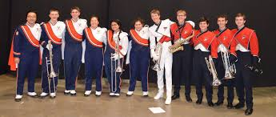
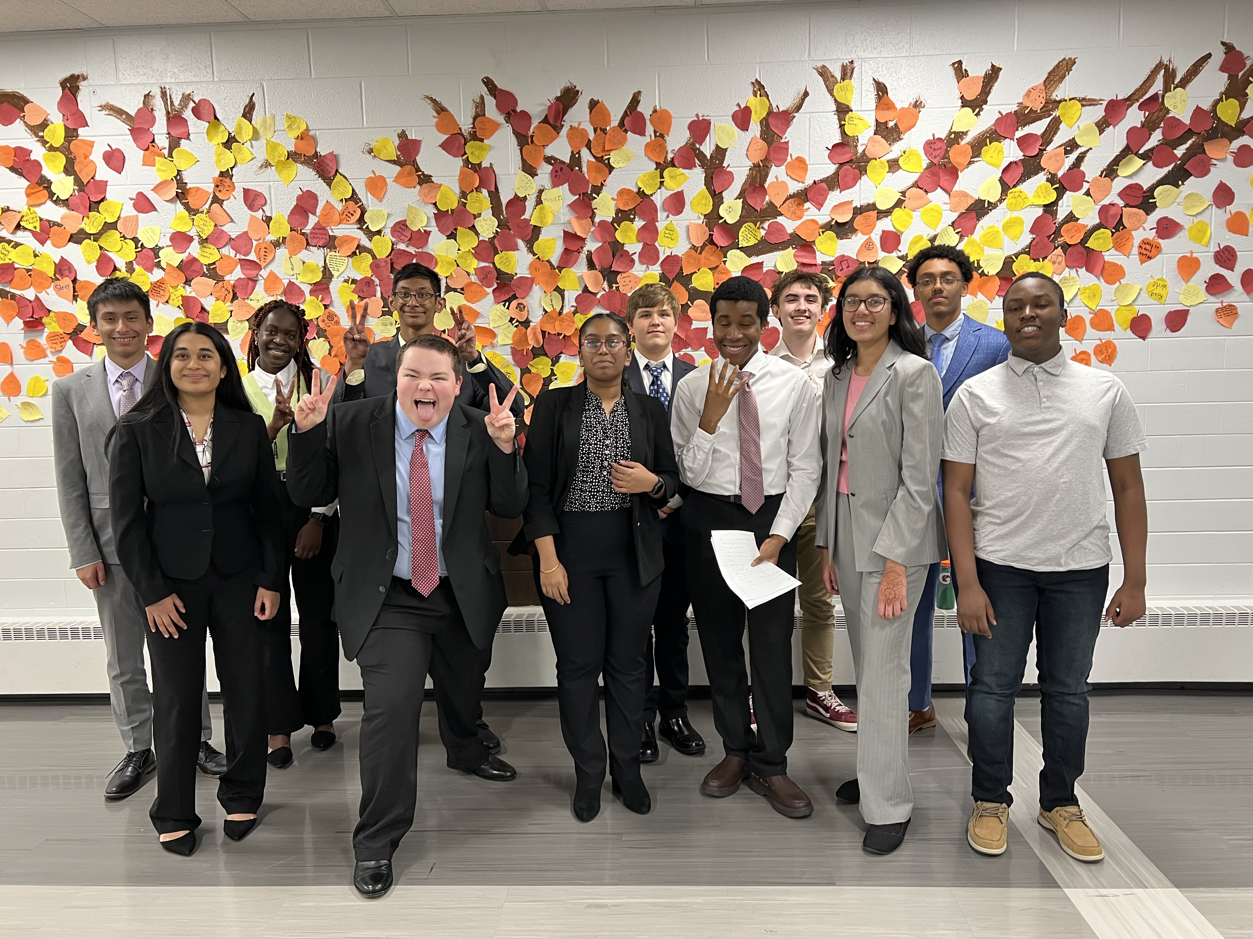
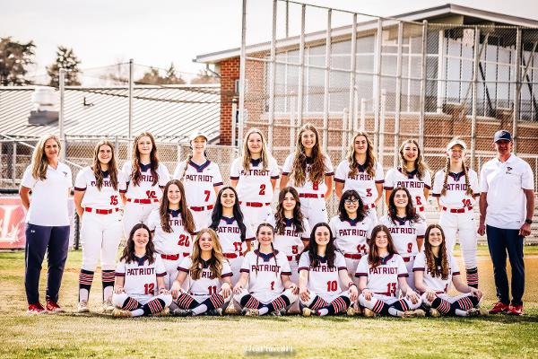
LOGISTICS
Lockers can be assigned; however, most students carry a backpack. Musicians and athletes arrange with their instructors or coaches where and how to store their equipment.
We recommend that students keep a calendar or agenda to keep their assignments straight & remind them of the daily schedule.
There are many extracurricular activities!! Check the Patriot Homepage to see the variety. If there’s something you’re interested in but don’t see, start your own club!
There are many academic competitions and opportunities outside of the school that are available as well.
Successful graduates encourage involvement in clubs and sports with other passionate students!!

Slide 5
FRESHMEN SEMINAR
Freshmen students in the Gifted Education Program will think about and discuss a variety of topics and issues that concentrate on “What do we know? And how do we know it? In addition, students will participate in a variety of activities using written and artistic expression, as well as simulation. The curriculum provided by Prince William County includes the following themes for the experience:
DIFFERENTIATED SERVICE PLAN (Future Planning)
GIFTEDNESS
LANGUAGE
ART
MATHEMATICS (Order & Disorder)
HISTORY
SCIENCE
ARTIFICIAL INTELLIGENCE
PERSONALITY (MBTI EMOTIONAL INTELLIGENCE)
CREATIVITY
MULTIPLE INTELLIGENCES

Slide 6
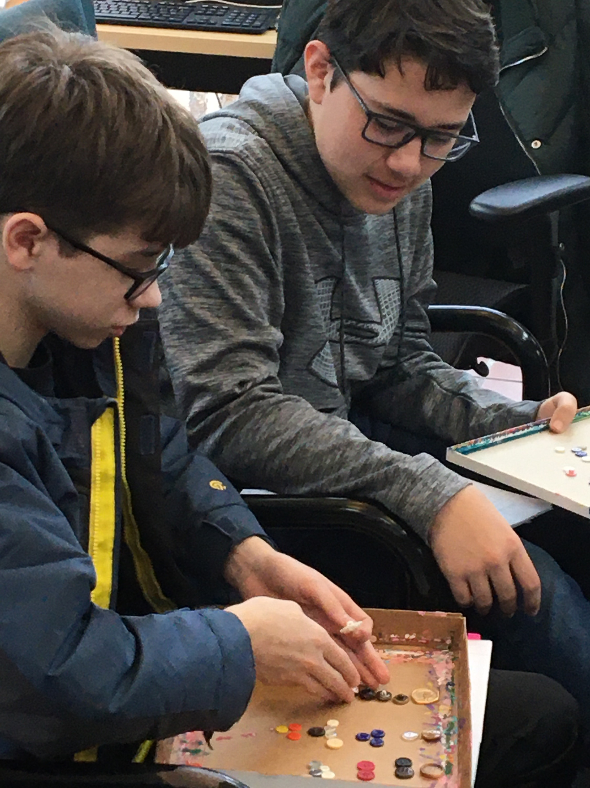
SIMILARITIES & DIFFERENCES
Historically, students are ‘clustered’ in Language Arts classes for services. Sometimes personal passes will allow flexibility for students to select when they attend.
Canvas contains our modules, students may ‘opt’ to access the opportunity virtually.
Underclass Gifted Pioneers are offered twelve 90-minute seminars throughout the school year.
We love the opportunity to challenge our own thinking as well as those around us.
Seminars are “conversations about ideas.” Students are encouraged to defend their perspectives. This experience becomes a “Meeting of the Minds”

Slide 7
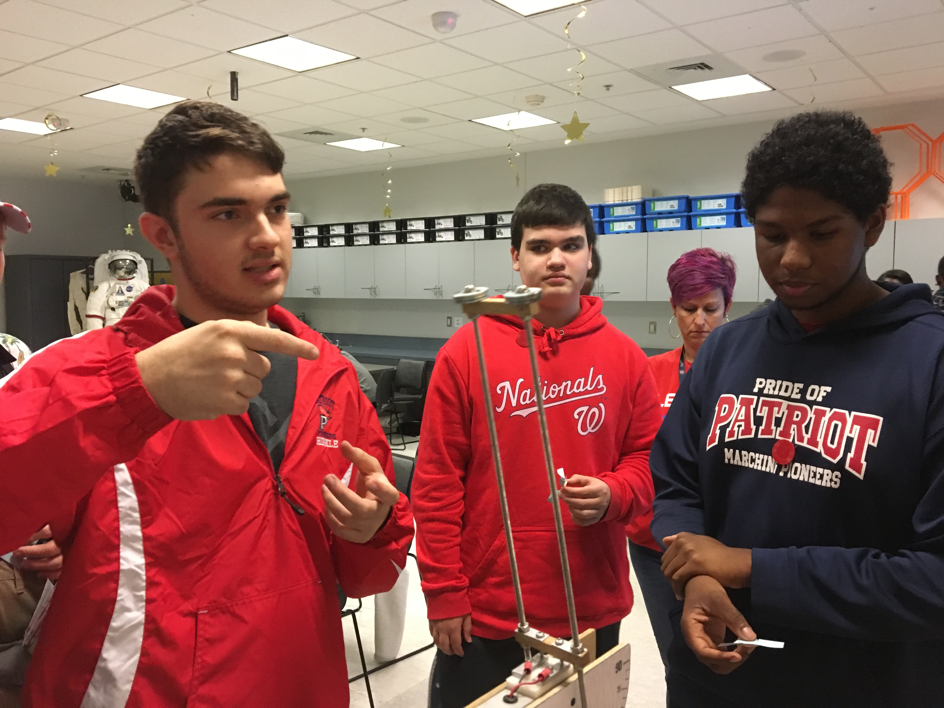
Field Trips
Prior to the pandemic, active Pioneers in the Gifted Program enjoy the collaboration & exploration off campus.
Freshmen: National Gallery of Art, East Wing, National Mall
Sophomores: Air & Space Museum, Chantilly
Juniors: American History Museum, National Mall
Seniors: Hirshhorn Museum and Sculpture Garden, National Mall
(left: Seniors and Sophomores construct propellers for maximum lift at the Udvar-Hazy Air & Space Muesum at Dulles Airport.)

Slide 8
Ponder & Reflect
An Intro to Seminar…
Please introduce yourself and offer up the name of one sport.
No two people can name the same sport
Be sure to speak to your peers, not to your teachers.
Watch not only what they communicate to you but also HOW they communicate it to you.
Did everyone agree with you? How did you know?

Slide 9
Contact Information
Patriot HS continues to provide Pioneers with in-person and online enrichment opportunities.
The Canvas Course for Gifted Education at Patriot High School as well as
the Patriot High School website informs students and parents of events!
Typically, there has been a freshman BRIDGING opportunity. This allows students to come into
Patriot a few weeks before school begins to ‘jump start’ their high school career.
Freshman orientation provides students and parents an ‘open house’ before school begins
to get their schedule and explore the building. Staff could be available to assist and become acquainted.
If you have questions or concerns, you are more than welcome to contact me.
Find Gifted Ed information on the PATRIOT HIGH SCHOOL HOMEPAGE →
OUR SCHOOL / SPECIALTY PROGRAM / GIFTED EDUCATION
Adrienne Phillips
philliac@pwcs.edu
Gifted Education Resource Teacher

